Slide 1
Day 2 (MM/DD/YYYY)
D-Code

Slide 2
try{whatDoYouRemember()}
Notes:
Review: What is programming? What is the purpose of our working agreement? What does Dev Tools help you do? How do you open an element in Dev Tool?

Slide 3
Standup
Add to our Developer Toolbox
What is HTML
Hello World!!
Tag You’re It

Slide 4
break;
What tool do many web developers use to write their code for web pages?

Slide 5
continue;
Many web developers use text editors such as Sublime Text or Atom.

Slide 6
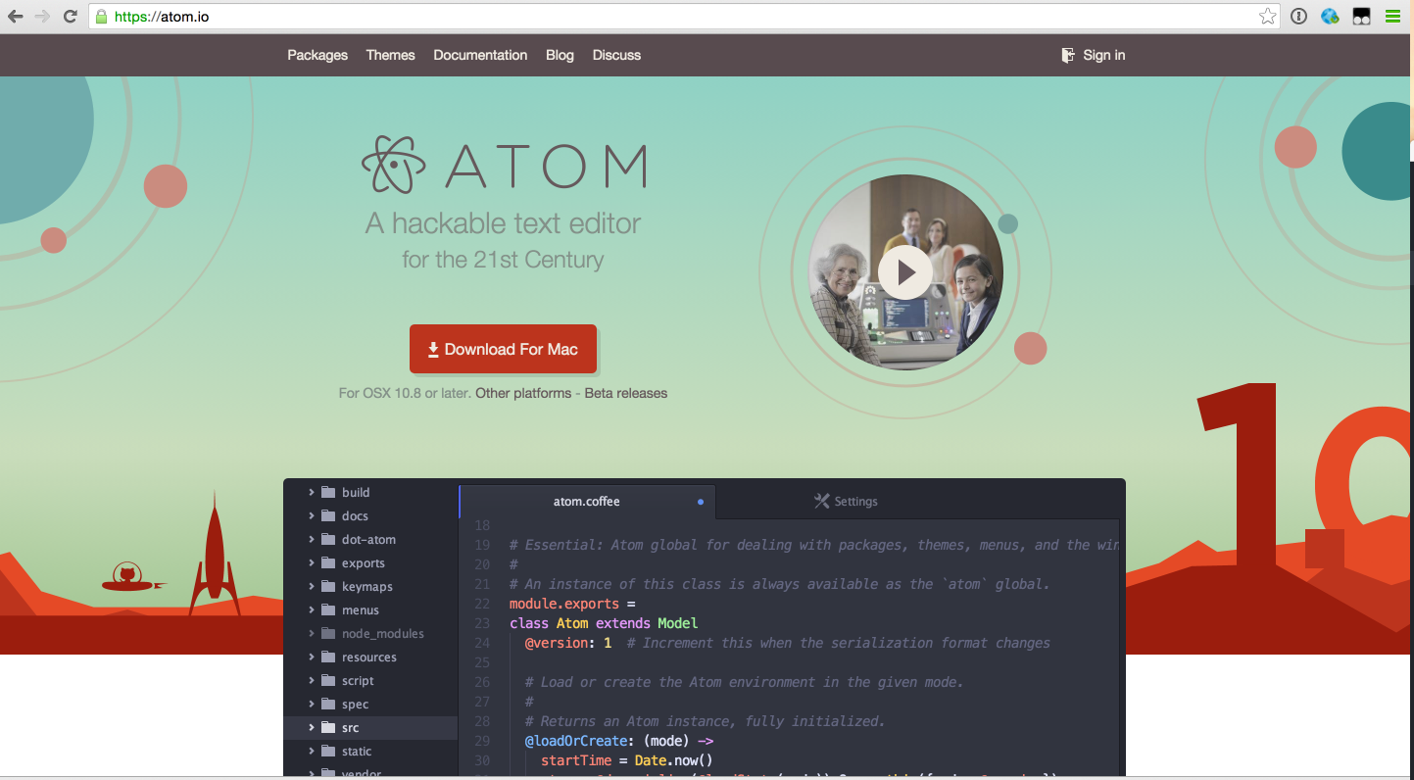
Atom
Go to the following website: https://atom.io

Slide 7

Atom
Click “Other Platforms” link found under the Download For Mac button.

Slide 8
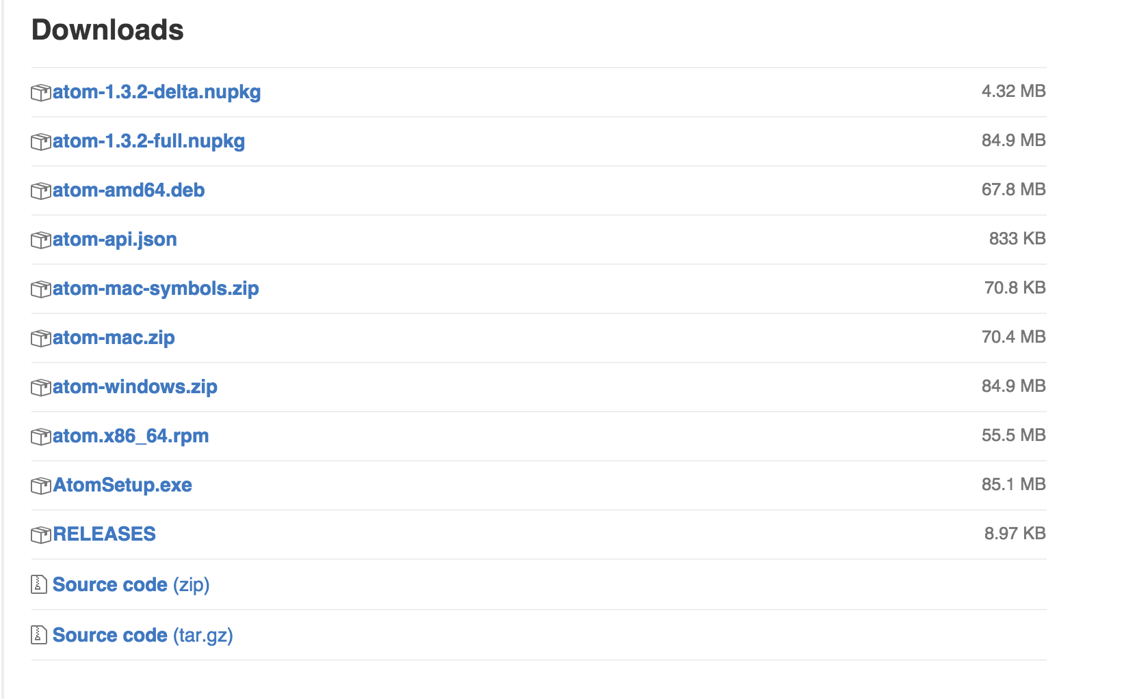
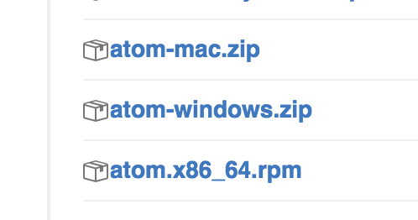
Atom
Select the ”atom-windows-zip”

Slide 9
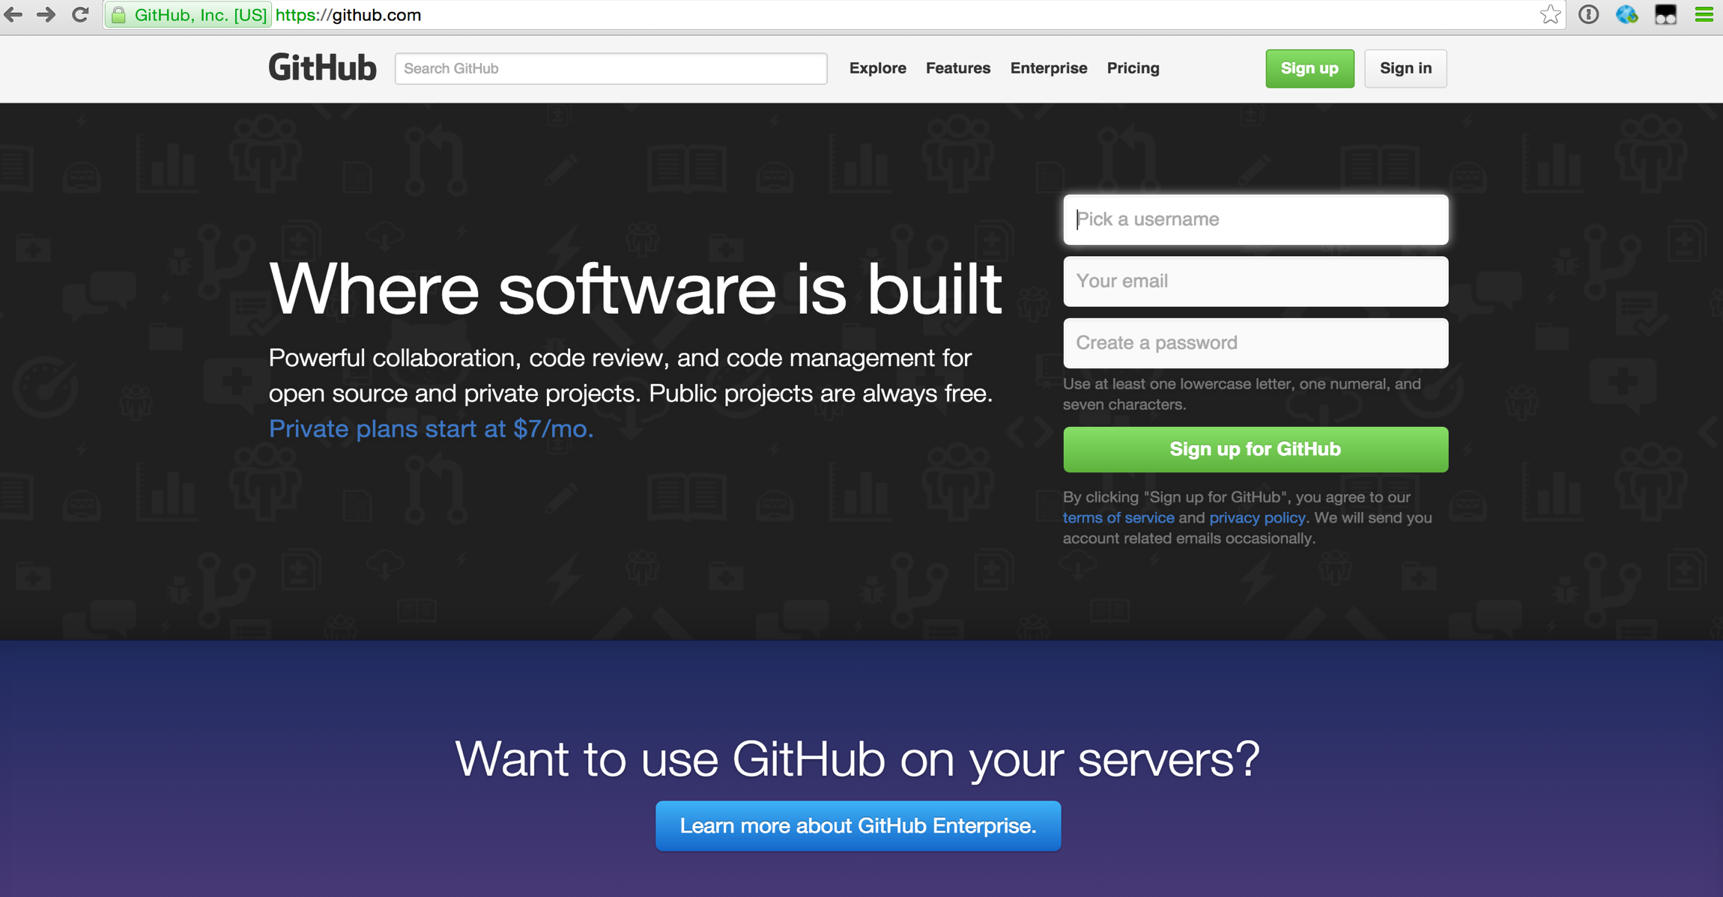
Github
Go to the following website: https://github.com

Slide 10
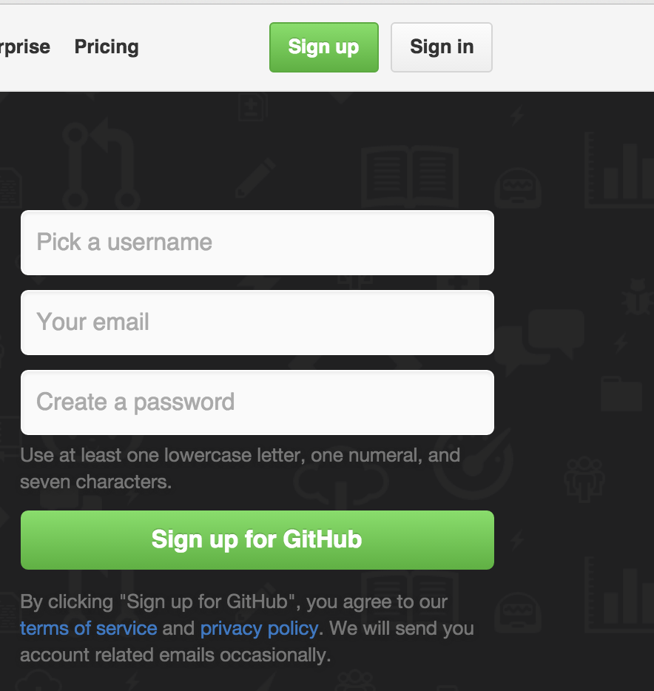
Github
Go to the following website: https://github.com
Click ”Sign up”

Slide 11
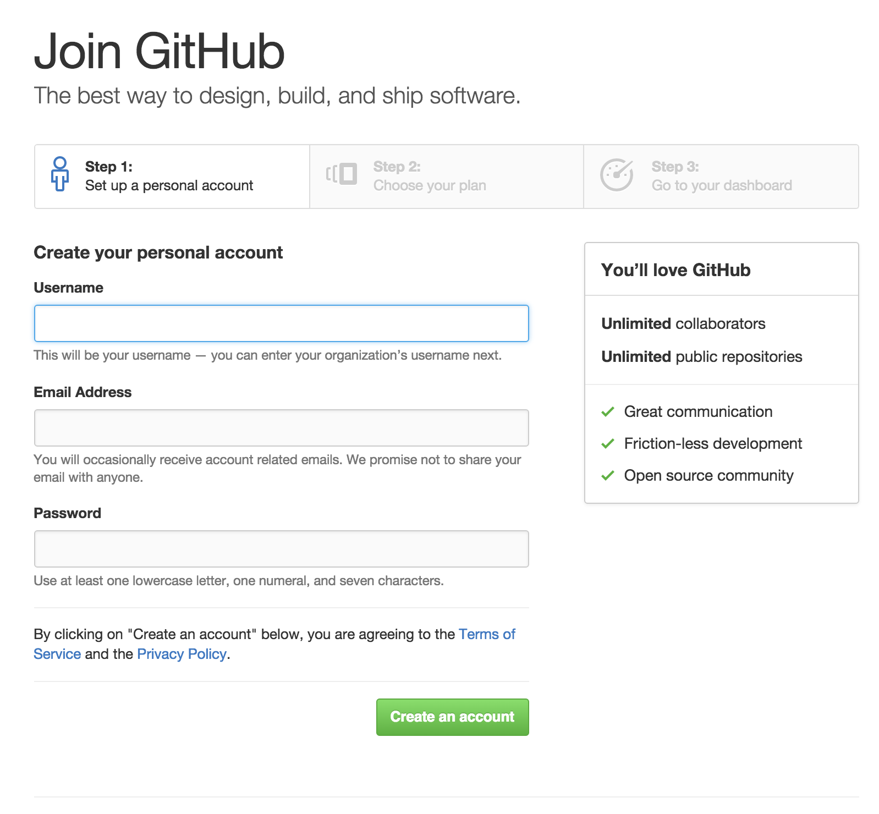
Github
Go to the following website: https://github.com
Click ”Sign up”
Create an account

Slide 12
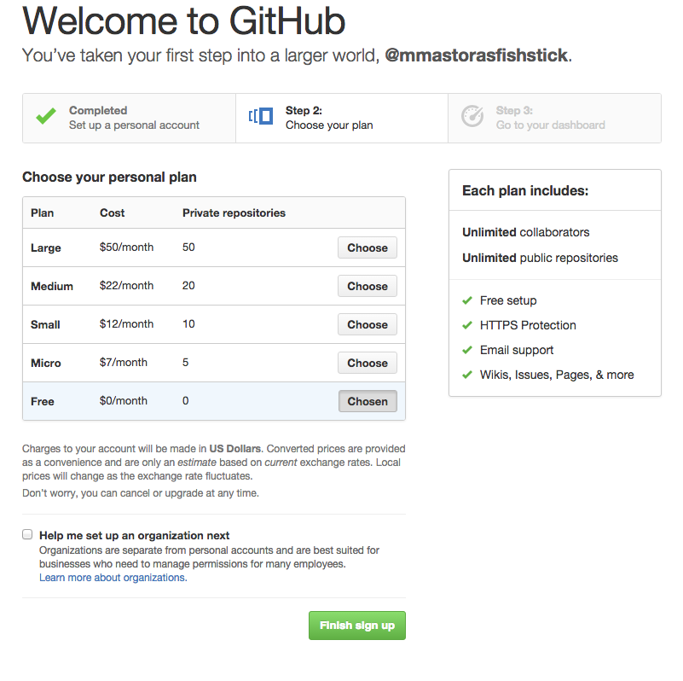
Github
Go to the following website: https://github.com
Click ”Sign up”
Create an account
Choose the Free Plan

Slide 13

Khan Academy
Go to the following website: www.khanadacemy.org

Slide 14
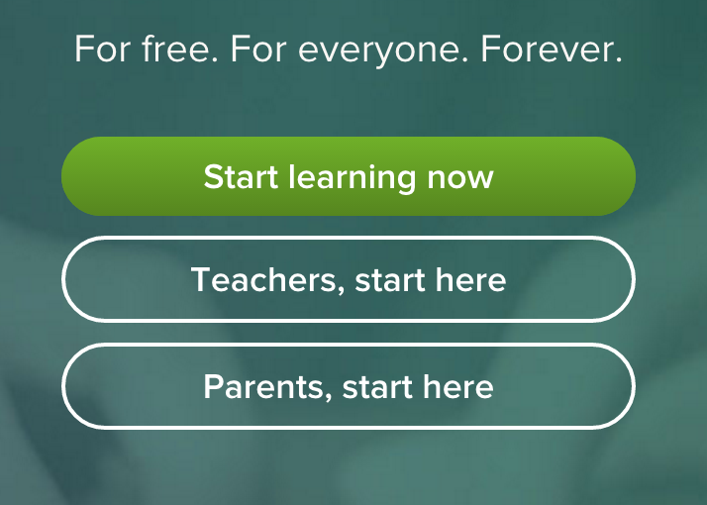
Khan Academy
Click “Start Learning”

Slide 15
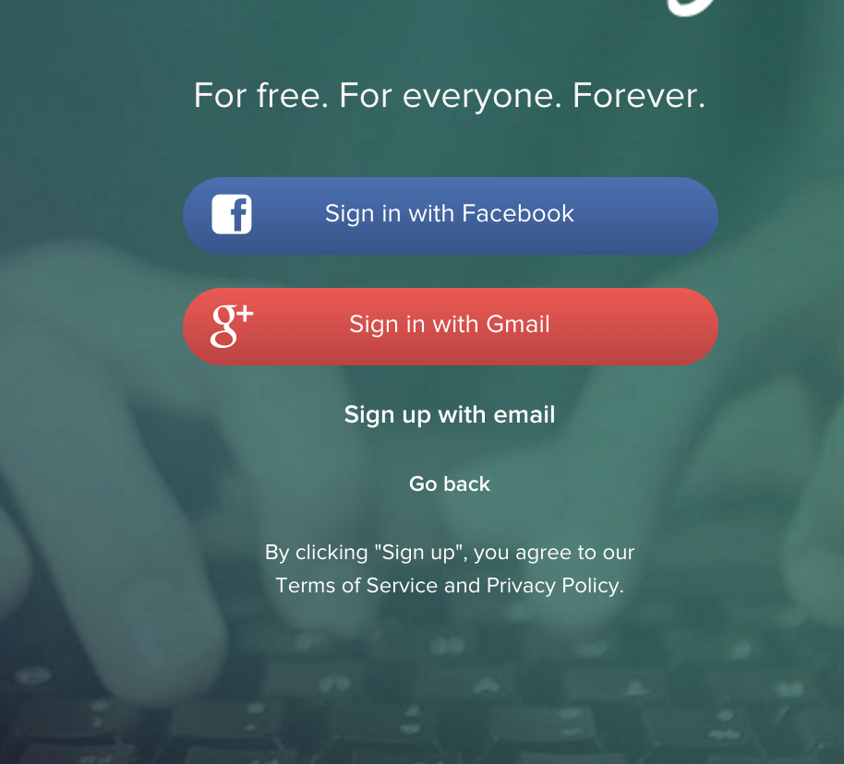
Khan Academy
Go to the following website: www.khanadacemy.org
Click “Start Learning”
Select “Sign up with email”

Slide 16
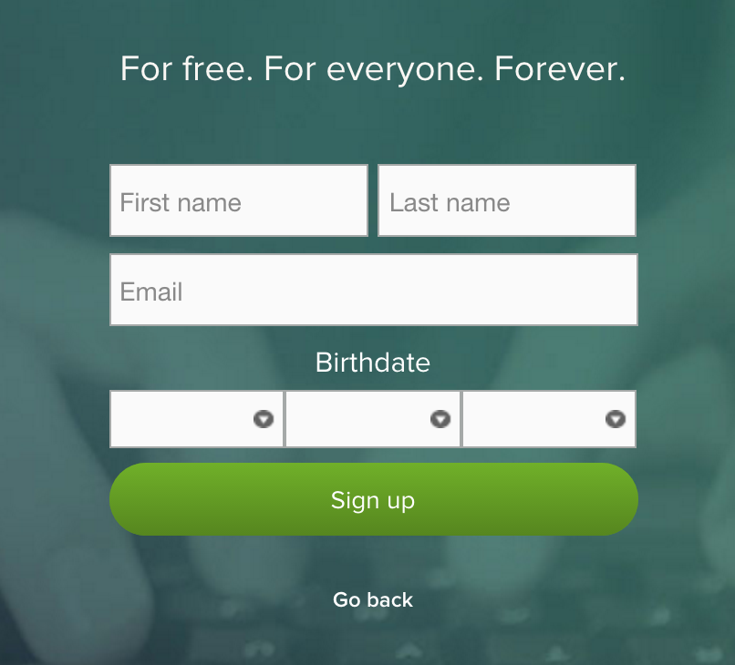
Khan Academy
Complete the sign up form

Slide 17
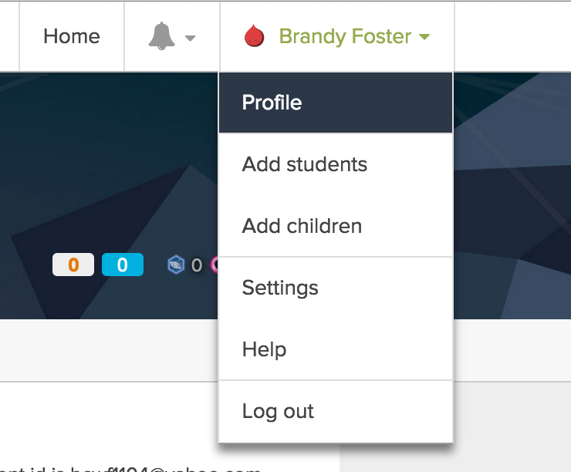
Khan Academy
Select your name and go to your profile

Slide 18
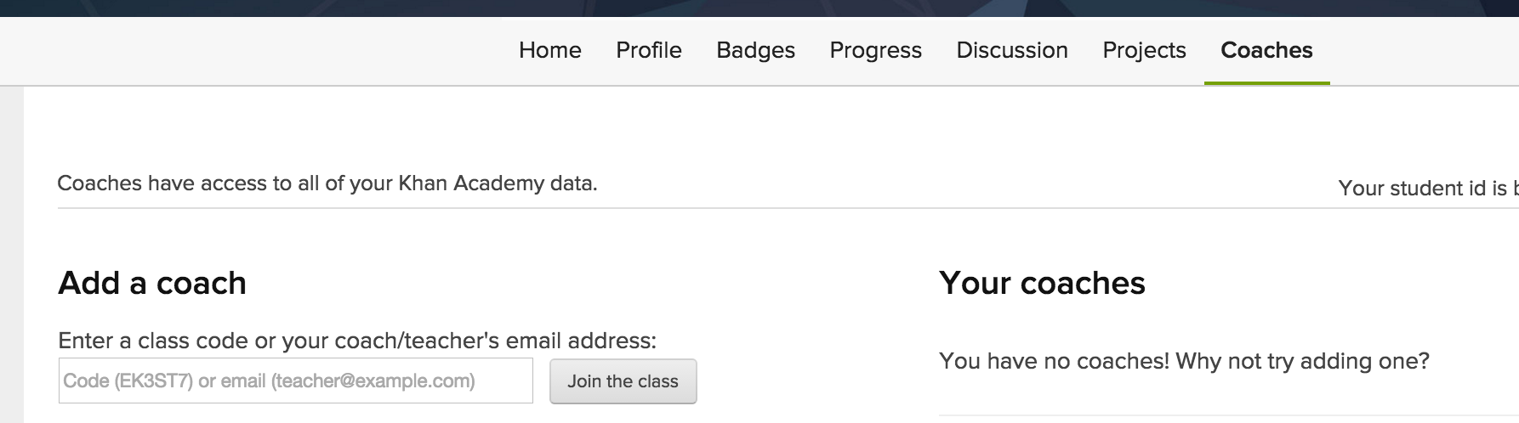
Khan Academy
Open the “Coaches” tab
In Add a Coach enter class code: P7YVGM
Click “Join the class”
In the Add a Coach enter: kyle.ofori@detroitlabs.com
Click “Join the class”

Slide 19
If you teach a fish to man
Better known as
“If you teach a man to fish,
he will never go hungry.”
Resources for Always Learning:
CodeAcademy
Udacity
Khan Academy
And most vital Stack Overflow
Notes:
After discussing this slide, have the class open the zip file which should be downloaded and finish downloading Atom.

Slide 20
Udacity Challenge v02
Type the following in your browser:
http://udacity.github.io/js-basics/static-home/index.html
What is on an HTML web page?

Slide 21

Time Remaining: 5 mins
Notes:
5 minute break for the students

Slide 22
Huddle
Add to our Developer Toolbox
What is HTML
Hello World!!
Tag You’re It
Notes:
Any questions?

Slide 23
break;
What does HTML stand for?

Slide 24
HTML Speaks
HTML aka Hypertext Markup Language
programming language === false;
Defines the structure of the web page
Uses tags<></>
Tree like structure
Notes:
HTML stands for Hypertext Markup Language. It’s not a programming language; it’s the markup language used to create websites. (Sort of like taking notes in the margin of a paper; you’ve got the actual information, then the stuff you write about the information.) Web browsers “render” it to show webpages.
Developers try to keep the “stuff you write about the information” to structure, like where it falls on the page. They use CSS to make it look nice (“styling”), and JavaScript to make it interactive.

Slide 25
Huddle
Add to our Developer Toolbox
What is HTML
Hello World!!
Tag You’re It
Notes:
Any questions?

Slide 26
Hello World!!

Slide 27
If you write it…
If(DCode Folder == null){
Make a new folder on your desktop named Dcode.
}
Make a new folder in Dcode named helloWorld.
Open a new document in Atom.
(File > ) Save As…
Save file in DCode as helloWorldHTML.html
Open Chrome (browser) and
Open helloWorldHTML.html (File > Open File…)
We’ll use this Atom document to make our first webpage, and we’ll see it develop on Chrome.

Slide 28
What Goes Where?
Struc·ture
ˈstrək(t)SHər/
noun
1. the arrangement of and relations between the parts or elements of something complex.
Notes:
Structure: what is where on the page. Think of a newspaper, and how some things are written in bigger text than others, and headers, and images in one place...everything helps you understand better what’s going on in the article.
Sure you can think of other examples of media that has structure. (FB, Instagram)
Structural markup: elements used to describe headings and paragraphs

Slide 29
Elements
Individual component of HTML document web page.
We see them in the document-object model when we look at webpages using developer tools.
Elements tell browser something about the information they contain.
Includes Tags and information between them

Slide 30
Tags
Marks the beginning and end (usually) of each element.
Keywords surrounded by angle brackets.
Describes the type of element (<head>, <title>, <body> or <footer> )
Always Open < > (ex: <head>)
Sometimes Closes </ > (ex: </head>)

Slide 31
<!DOCTYPE html>
HTML Tag === false;
Declares which version of HTML your page is using
This is declaring the latest version of HTML (which currently is HTML5)
<!DOCTYPE html>
<html>
</html>

Slide 32
Your First Web Page!!
<!DOCTYPE html>
<html>
<head>
<title>First Web Page</title>
</head>
<body>
<h1>Hello World!!</h1>
<h2>by: (your name here)</h2>
<p>You just wrote a webpage using HTML!
Next we are going to look at these elements</p>
</body>
</html>

Slide 33
while(writingCode);
SAVE YOUR PROGRESS!!!
File > Save
or
Ctrl + S

Slide 34
<head></head>
Contains information about the page
Contains the page’s <title>
Contains <link> to other external files
<head>
<title>My First Web Page</title>
</head>
Notes:
Notice how title’s opening and closing elements are both inside of the head element? That’s called nesting. Some elements nest inside of others. First to open will be last to close, and v.v.

Slide 35
Your First Web Page!!
<!DOCTYPE html>
<html>
<head>
<title>First Web Page</title>
</head>
<body>
<h1>Hello World!!</h1>
<h2>by: (your name here)</h2>
<p>You just wrote a webpage using HTML!
Next we are going to look at these elements</p>
</body>
</html>
Notes:
Remind students to save again

Slide 36
<body></body>
Contains the HTML document including text, buttons, tables, etc.
<body>
</body>

Slide 37
Your First Web Page!!
<!DOCTYPE html>
<html>
<head>
<title>First Web Page</title>
</head>
<body>
<h1>Hello World!!</h1>
<h2>by: (your name here)</h2>
<p>You just wrote a webpage using HTML!
Next we are going to look at these elements</p>
</body>
</html>
Notes:
Remind students to save again

Slide 38
<h1></h1>-<h6></h6>
Defines Headings
Range in size from <h1> which is the largest to <h6> which is the smallest
Used to organize information on the page from most important to least important
<h1>Hello World!!</h1>
<h2>by: (your name here)</h2>

Slide 39
Your First Web Page!!
<!DOCTYPE html>
<html>
<head>
<title>First Web Page</title>
</head>
<body>
<h1>Hello World!!</h1>
<h2>by: (your name here)</h2>
<p>You just wrote a webpage using HTML!
Next we are going to look at these elements</p>
</body>
</html>
Notes:
Remind students to save again

Slide 40
<p></p>
Defines Paragraphs
Small text, usually the bulk of the page content
<p>You just wrote a webpage using HTML!
Next we are going to look at these elements</p>

Slide 41
Your First Web Page!!
<!DOCTYPE html>
<html>
<head>
<title>First Web Page</title>
</head>
<body>
<h1>Hello World!!</h1>
<h2>by: (your name here)</h2>
<p>You just wrote a webpage using HTML at </p>
</body>
</html>
Notes:
Save!

Slide 42
Attributes
Key/Value Pairs
Keys define the attribute
Values set the value of the attribute
Provides additional info about/Modifies HTML elements
Always specified in the start tag
<h1 align=“center”>

Slide 43
Your First Web Page!!
<!DOCTYPE html>
<html>
<head>
<title>First Web Page</title>
</head>
<body>
<h1 align=“center”>Hello World!!</h1>
<h2>by: (your name here)</h2>
<p>You just wrote a webpage using HTML at</p>
</body>
</html>
Notes:
Save!

Slide 44
break;
Can you change the direction of text using HTML attributes?

Slide 45
continue;
Yes you can! Using the dir attribute you can change the direction of the text in an element. There are about 118 different HTML tags though not all are supported by HTML5. And these tags can be modified by many different attributes.

Slide 46
<ol></ol>
Defines an ordered list
Increments numerically as items are added
Each item needs a <li></li> tag
<ol>
<li>Create new HTML file</li>
<li>Add HTML code</li>
<li>Save file</li>
<li>Open file in browser</li>
</ol>

Slide 47
Your First Web Page!!
<!DOCTYPE html>
<html>
<head>
<title>First Web Page</title>
</head>
<body>
<h1 align=“center”>Hello World!!</h1>
<h2>by: (your name here)</h2>
<p>You just wrote a webpage using HTML at</p>
<ol>
<li>Create new HTML file</li>
<li>Add HTML code</li>
<li>Save file</li>
<li>Open file in browser</li>
</ol>
</body>
</html>
Notes:
Save!

Slide 48
<ul></ul>
Defines unordered list
Bullet-points items added
Each item needs <li></li> tag
<ul>
<li>Does page load?</li>
<li>Does page display properly?</li>
<li>Are you smiling?</li>
</ul>

Slide 49
Your First Web Page!!
<!DOCTYPE html>
<html>
<head>
<title>First Web Page</title>
</head>
<body>
<h1 align=“center”>Hello World!!</h1>
<h2>by: (your name here)</h2>
<p>You just wrote a webpage using HTML at</p>
<ol>
<li>Create new HTML file</li>
<li>Add HTML code</li>
<li>Save file</li>
<li>Open file in browser</li>
</ol>
<ul>
<li>Does page load?</li>
<li>Does page display properly?</li>
<li>Are you smiling?</li>
</ul>
</body>
</html>
Notes:
Save!!

Slide 50
<a></a>
Defines a hyperlink
Needs href attribute to define link destination
By default
Unvisited links are blue underlined text
Visited links are purple underlined text
Active links are red underlined text
<a href=“http://www.detroitedisonpsa.org”>DEPSA</a>

Slide 51
Your First Web Page!!
<!DOCTYPE html>
<html>
<head>
<title>First Web Page</title>
</head>
<body>
<h1 align=“center”>Hello World!!</h1>
<h2>by: (your name here)</h2>
<p>You just wrote a webpage using HTML at
<a href=“http://www.detroitedisonpsa.org”>DEPSA</a>
</p>
<ol>
<li>Create new HTML file</li>
<li>Add HTML code</li>
<li>Save file</li>
<li>Open file in browser</li>
</ol>
<ul>
<li>Does page load?</li>
<li>Does page display properly?</li>
<li>Are you smiling?</li>
</ul>
</body>
</html>

Slide 52
Ship It!
In Chrome:
Click “File”,
Select “Open File”
Open “HelloWorldHTML.html
Notes:
Discussion:
If there are any errors on their pages:
-What could we have done while developing to catch them sooner?
*Importance of testing and refactoring during the development cycle.
-Remember that time you waited until the last minute to write that paper??

Slide 53
Varieties of Fishes
Resources for HTML
MDN (developer.mozilla.org/en-US/docs/Web/HTML)
Resources for HTML tags
W3 Schools (www.w3schools.com/tags/)
HTML Dog (www.htmldog.com/references/html/tags/)

Slide 54
Huddle
Add to our Developer Toolbox
What is HTML
Hello World!!
Tag You’re It
Notes:
Any questions?

Slide 55
try{groupOf5([3]);}
Use the following tags for this assignment:
groupOf5[0]= <b> <i>
groupOf5[1]= <sup> <sub>
groupOf5[2]= <br> <hr>
Answer the following questions:
What does this tag define?
What is this tag used for?
Choose 1 of the 2 tags and add an example to your individual HTML documents

Slide 56
Dev Complete
Add to our Developer Toolbox
What is HTML
Hello World!!
Tag You’re It
Testing… testing.. 123

Slide 57
finally{
talkAboutWhatWe’veLearned();
}
Notes:
Discuss the topics covered:
Tools used to develop:
What HTML means:
Tags:
HelloWorld:
-How did it feel to develop a web page?
Team Assignment:
-How did it feel to work in a group?
-Why is team work is important in development?
Overall Day:
-What went well?
-What could have gone better?
-What will do we to improve?

Slide 58
Now We’re Done
Add to our Developer Toolbox
What is HTML
Hello World!!
Tag You’re It
At least… by our definition of done.

